Slide 1
Online Biostatistics Lab
Brian McKay
Department of Epidemiology and Biostatistics
University of Georgia

Slide 2
Motivation
Students were not satisfied with the in-person lab
Allow students to set their own pace and revisit concepts
Improving data literacy through interactive exercises
Introduce students to statistical programing
Move away from proprietary software
Notes:
Students had issues with both the content and having to come to HSC.
Students can move faster or slower depending on their understanding of the topic
Data literacy through experimentation and interpretation of results
Getting students to code in an environment that minimizes frustrations
Introduce tools that are available to students after the class is over and once they graduate
Also there is a general move in the field as well

Slide 3

Implementation
R and Markdown in RStudio
Free and open source
Large user group
Widely used in biostatistics and other data analysis fields

Slide 4
Implementation
The labs are created using “Shiny” and “learnR” packages
Shiny is used to create the interactive exercises
learnR provides the basic structure and navigation of the lab
Extremely flexible
Notes:
Show the RMD file for one of the labs.

Slide 5
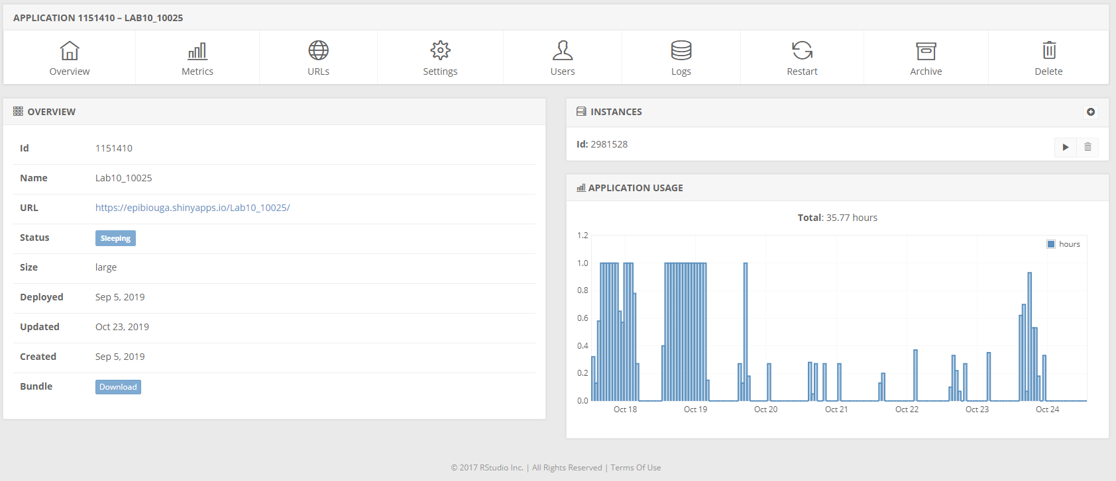
Implementation
Labs are hosted on RStudio Server
Easy integration
Students do not have to install any programs locally
Notes:
Getting a software to work on students computers can be very frustrating. Especially is there are 140 students!
It also reduces student frustration and allows the instructor to focus on the content.

Slide 6
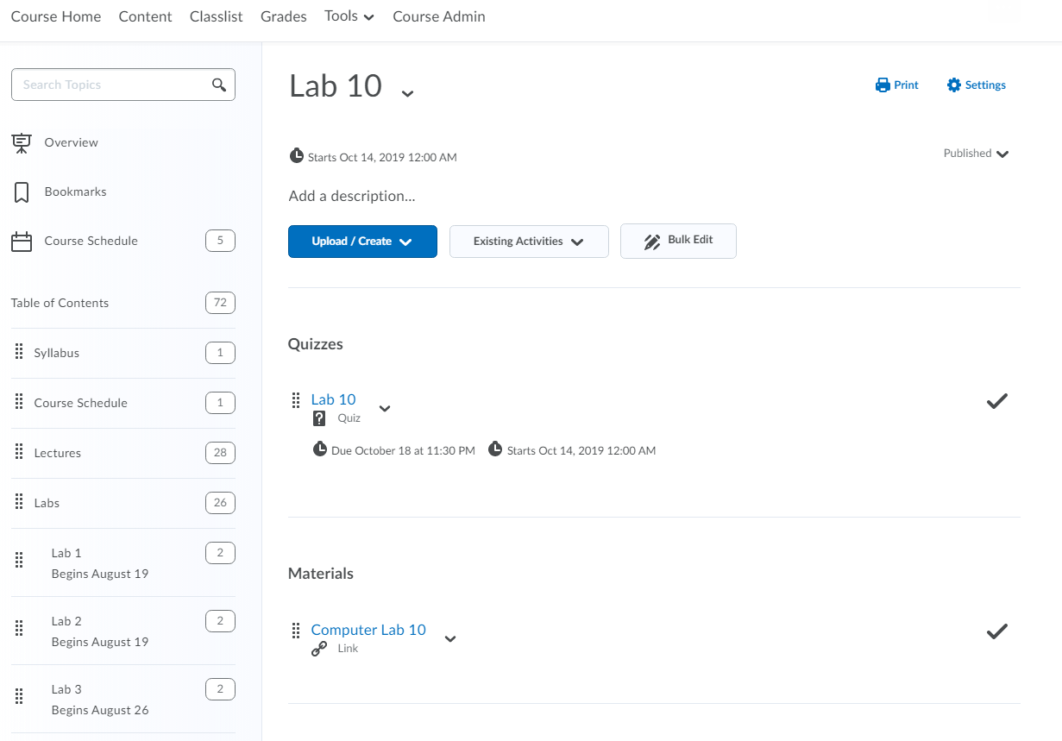
Implementation
Student access and assessment
eLC
Leverages existing resources
Student Support
Single eLC course
Discussion boards
TA Chat
Zoom Meetings with TA’s

Slide 7
Demonstration
Lab 8
Lab 10

Slide 8
Any Questions?

